Slide 1

2.1.3 Geometric interpretation of real 2- and 3-dimensional vectors

Slide 2
Introduction
In this topic, we will
  Look at geometric interpretations of 2-dimensional vectors
  Consider geometric interpretations of 3-dimensional vectors

Slide 3

2-dimensional vectors
Real two-dimensional vectors can be interpreted as points on a plane
  Generally, the axes are labeled x and y
  2-d vectors are interpreted as coordinates in the x-y–plane
    The first entry corresponds
    to the x coordinate
    The second entry corresponds
    to the y coordinate

Slide 4

2-dimensional vectors
We may or may not
  Put labels on the axes
  Put arrow heads on the axes
You should understand the
significance of the positions
  Unnecessary ink on a graphic that
  does not help comprehension
  is referred to by Tufte as chartjunk
In some cases, if the actual values
don’t matter, we may not even
include the tick marks and labels

Slide 5
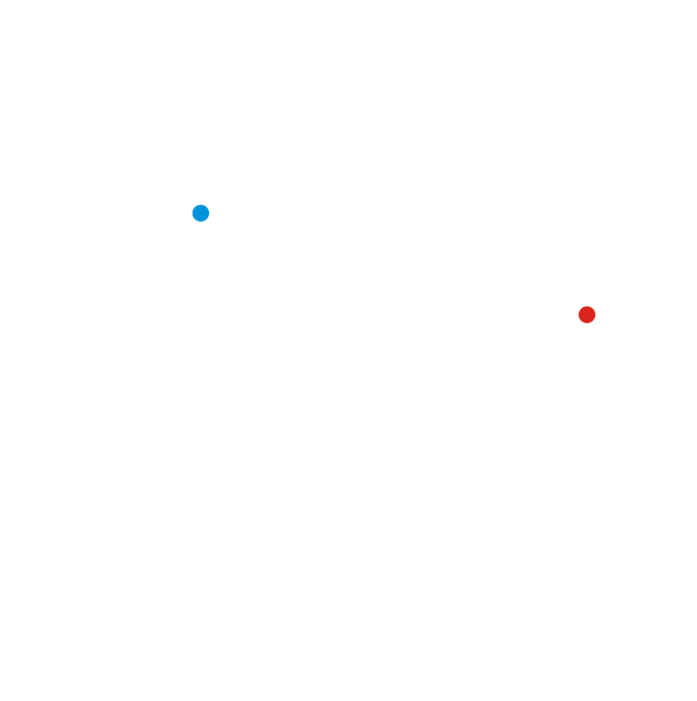
2-dimensional vectors
Here are two examples
The zero vector is at the intersection
of the axes

Slide 6

3-dimensional vectors
Real three-dimensional vectors can be interpreted as points in space
  Generally, the axes are labeled x, y and z
  3-d vectors are interpreted as coordinates in 3-space
  The orientation of the positive
  x-, y- and z-axes depends on the
  right-hand rule

Slide 7
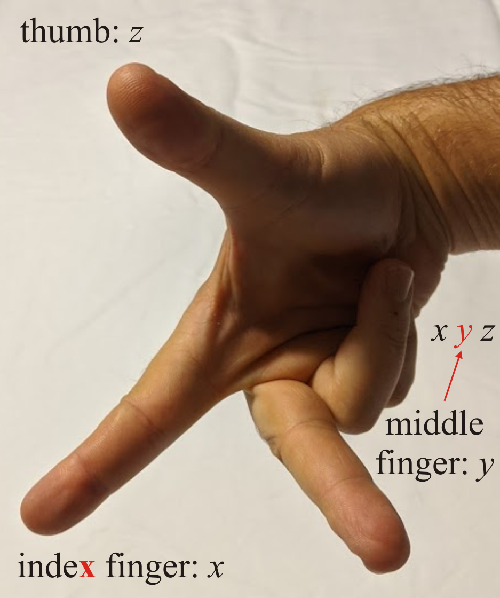
3-dimensional vectors
The right-hand rule indicates the directions of the positive x-, y- and z-axes using the index and middle fingers and the thumb:

Slide 8
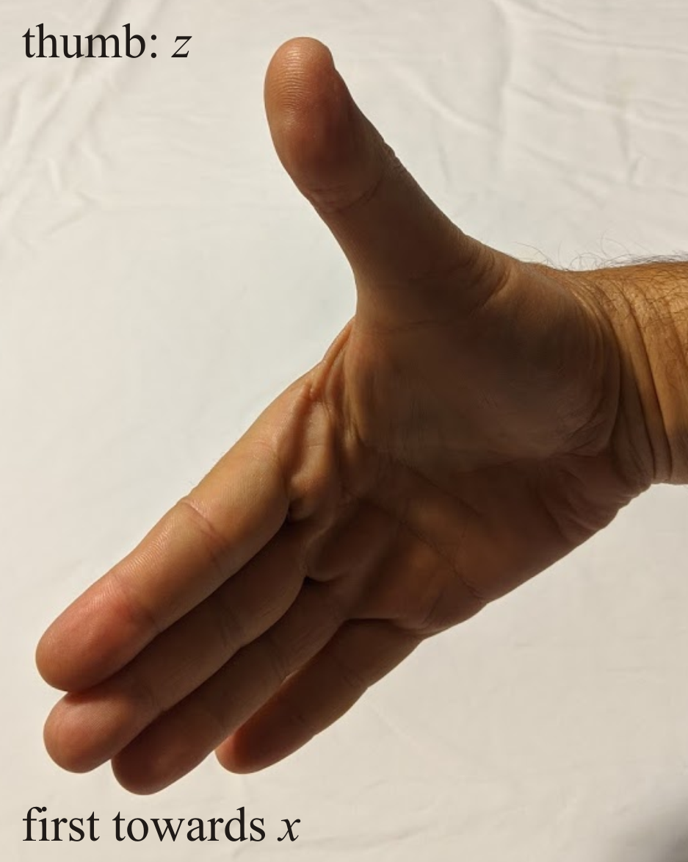
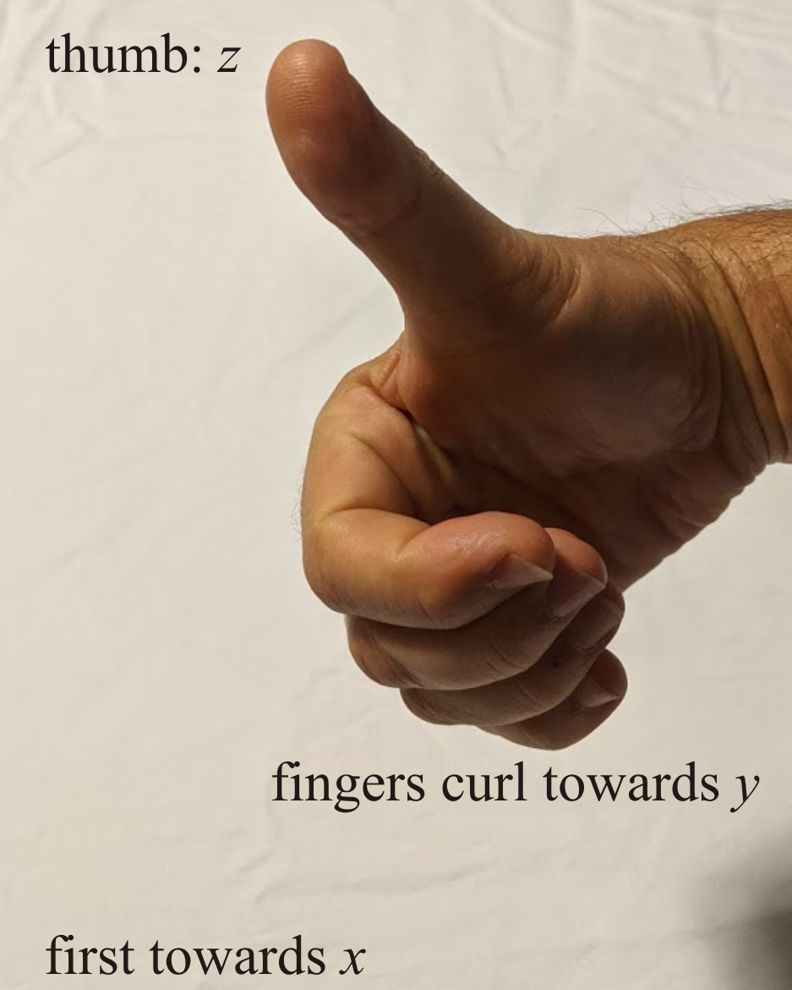
3-dimensional vectors
Alternatively, if the thumb points in the direction of positive z,
and the fingers point in the direction of positive x,
curling the fingers moves towards positive y

Slide 9
3-dimensional vectors
Visualizing a point in 3-space can be more challenging
  It requires visual cues
v

Slide 10
3-dimensional vectors
Visualizing a point in 3-space can be more challenging
  It requires visual cues
v

Slide 11
3-dimensional vectors
Visualizing a point in 3-space can be more challenging
  It requires visual cues
v

Slide 12
3-dimensional vectors
Visualizing a point in 3-space can be more challenging
  It requires visual cues
v

Slide 13
3-dimensional vectors
Visualizing a point in 3-space can be more challenging
  It requires visual cues
v

Slide 14
Summary
Following this topic, you now
  Seen interpretations of 2-dimensional vectors
  Seen interpretations of 3-dimensional vectors
  Are aware of the right-hand rule for the axes is 3-space

Slide 15
References
[1] https://en.wikipedia.org/wiki/Linear_algebra

Slide 16
Acknowledgments
None so far.

Slide 17



Colophon
These slides were prepared using the Cambria typeface. Mathematical equations use Times New Roman, and source code is presented using Consolas.
The photographs of flowers and a monarch butter appearing on the title slide and accenting the top of each other slide were taken at the Royal Botanical Gardens in October of 2017 by Douglas Wilhelm Harder. Please see
https://www.rbg.ca/
for more information.

Slide 18
Disclaimer
These slides are provided for the ne 112 Linear algebra for nanotechnology engineering course taught at the University of Waterloo. The material in it reflects the authors’ best judgment in light of the information available to them at the time of preparation. Any reliance on these course slides by any party for any other purpose are the responsibility of such parties. The authors accept no responsibility for damages, if any, suffered by any party as a result of decisions made or actions based on these course slides for any other purpose than that for which it was intended.

